Slide 1
Unit-II
Lasers

Slide 2
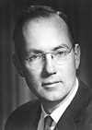

LASERS
History of the LASER
• Invented in 1958 by Charles Townes (Nobel prize
in Physics 1964) and Arthur Schawlow of Bell
Laboratories
• Was based on Einstein’s idea of the “particlewave
duality” of light, more than 30 years earlier
• Originally called MASER (m = “microwave”)

Slide 3
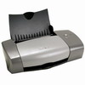

Laser: everywhere in your life
Laser printer
Laser pointer

Slide 4
What is Laser?
Light Amplification by Stimulated Emission of Radiation
A device produces a coherent beam of optical radiation by stimulating electronic, ionic, or molecular transitions to higher energy levels
When they return to lower energy levels by stimulated emission, they emit energy.

Slide 5
Properties of Laser
The light emitted from a laser is monochromatic, that is, it is of one color/wavelength. In contrast, ordinary white light is a combination of many colors (or wavelengths) of light.
Lasers emit light that is highly directional, that is, laser light is emitted as a relatively narrow beam in a specific direction. Ordinary light, such as from a light bulb, is emitted in many directions away from the source.
The light from a laser is said to be coherent, which means that the wavelengths of the laser light are in phase in space and time. Ordinary light can be a mixture of many wavelengths.
These three properties of laser light are what can make it more hazardous than ordinary light. Laser light can deposit a lot of energy within a small area.

Slide 6
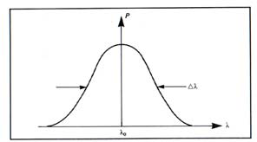
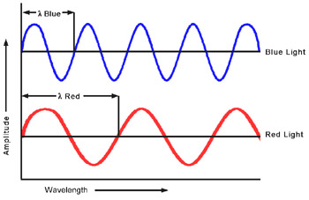
Monochromacity
Nearly monochromatic light
Example:
He-Ne Laser
λ0 = 632.5 nm
Δλ = 0.2 nm
Diode Laser
λ0 = 900 nm
Δλ = 10 nm
Comparison of the wavelengths of red and blue light

Slide 7
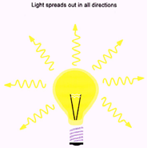
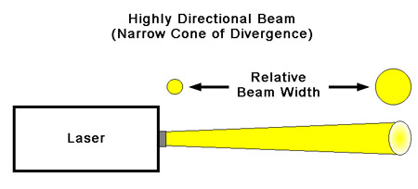
Directionality
Conventional light source Divergence angle (θd)
Beam divergence: θd= β λ /D
β ~ 1 = f(type of light amplitude distribution, definition of beam diameter)
λ = wavelength
D = beam diameter

Slide 8
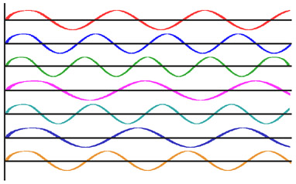
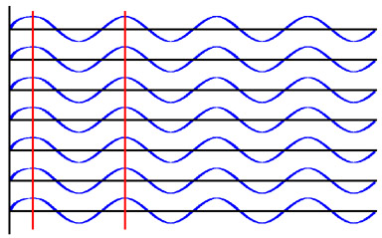
Coherence
Incoherent light waves Coherent light waves

Slide 9
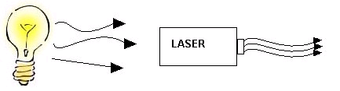
Incandescent vs. Laser Light
Many wavelengths
Multidirectional
Incoherent
Monochromatic
Directional
Coherent

Slide 10
Basic concepts for a laser
Absorption
Spontaneous Emission
Stimulated Emission
Population inversion

Slide 11
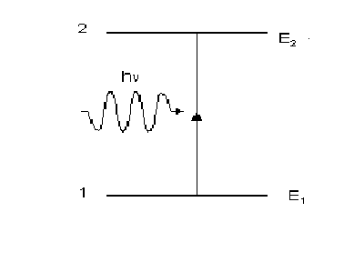
Absorption
Energy is absorbed by an atom, the electrons are excited into vacant energy shells.

Slide 12
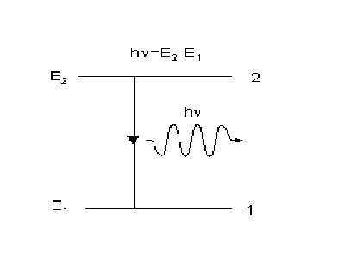
Spontaneous Emission
The atom decays from level 2 to level 1 through the emission of a photon with the energy hv. It is a completely random process.

Slide 13
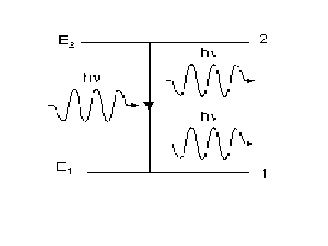
Stimulated Emission
atoms in an upper energy level can be triggered or stimulated in phase by an incoming photon of a specific energy.

Slide 14
Stimulated Emission
The stimulated photons have unique properties:
  In phase with the incident photon
  Same wavelength as the incident photon
  Travel in same direction as incident photon

Slide 15
Population Inversion
A state in which a substance has been energized, or excited to specific energy levels.
More atoms or molecules are in a higher excited state.
The process of producing a population inversion is called pumping.
Examples:
→by lamps of appropriate intensity
→by electrical discharge

Slide 16
Pumping
Optical: flashlamps and high-energy light sources
Electrical: application of a potential difference across the laser medium
Semiconductor: movement of electrons in “junctions,” between “holes”

Slide 17
Two level system
E₂
E₂
hν
hν
hν
hν =E₂-E₁
E₁
E₁
absorption
Spontaneous emission
Stimulated emission

Slide 18
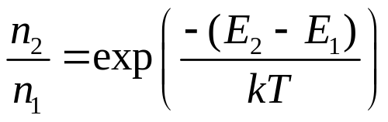
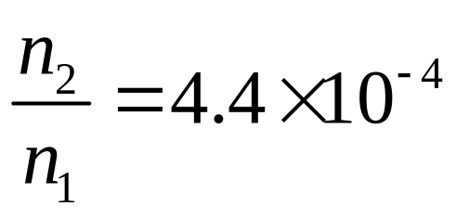
Boltzmann’s equation
E₂
E₁
example: T=3000 K E₂-E₁=2.0 eV
n₁ - the number of electrons of energy E₁
n₂ - the number of electrons of energy E₂
_{Population inversion- n2>>n1}

Slide 19
Resonance Cavities and Longitudinal Modes
Since the wavelengths involved with lasers and masers spread over small ranges, and are also absolutely small, most cavities will achieve lengthwise resonance
L = nλ
Plane parallel resonator
f
Hemifocal resonator
c
Concentric resonator
c
Hemispherical resonator
f
Confocal resonator
Unstable resonator
c: center of curvature, f: focal point

Slide 20
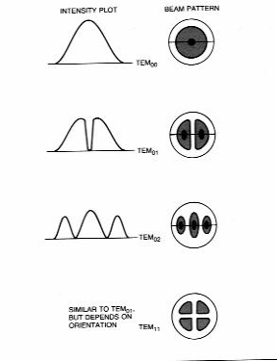
Transverse Modes
Due to boundary conditions and quantum mechanical wave equations
TEM₀₀:
I(r) = (2P/πd²)*exp(-2r²/d²)
(d is spot size measured to the 1/e² points)

Slide 21

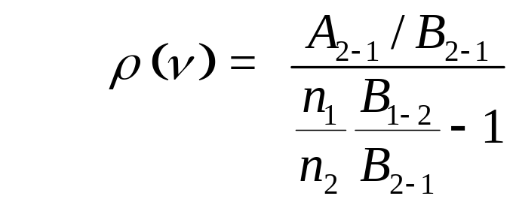
Einstein’s coefficients
Probability of stimulated absorption R₁₋₂
R₁₋₂ = ρ (ν) B₁₋₂
Probability of stimulated and spontaneous emission :
R₂₋₁ = ρ (ν) B₂₋₁ + A₂₋₁
assumption: n₁ atoms of energy ε ₁ and n₂ atoms of energy ε ₂ are in thermal equilibrium at temperature T with the radiation of spectral density ρ (ν):
n₁ R₁₋₂ = n₂ R₂₋₁ n₁ρ (ν) B₁₋₂ = n₂ (ρ (ν) B₂₋₁ + A₂₋₁)
E₂
E₁

Slide 22
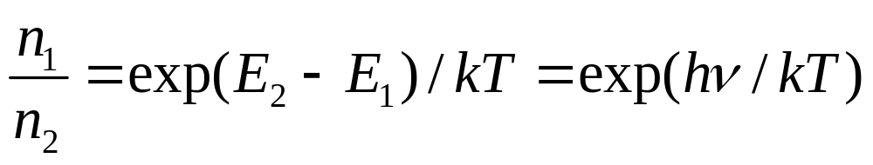
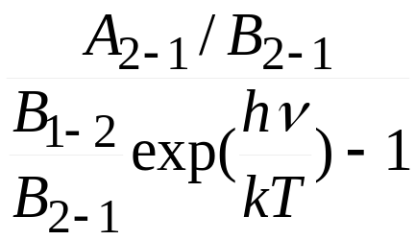
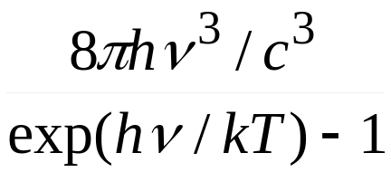
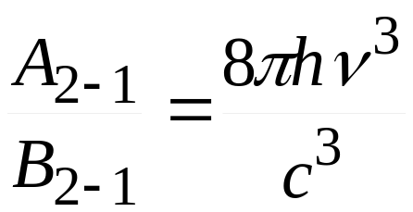
According to Boltzman statistics:
ρ (ν) = =
Planck’s law
B₁₋₂/B₂₋₁ = 1

Slide 23
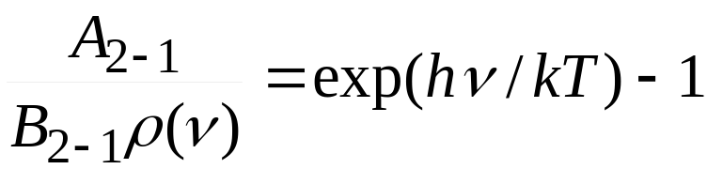
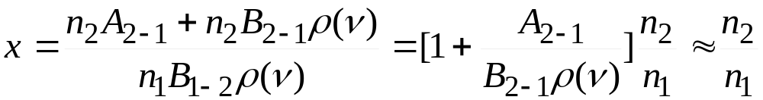
The probability of spontaneous emission A₂₋₁ /the probability of stimulated emission B₂₋₁ρ(ν ):
Visible photons, energy: 1.6eV – 3.1eV.
kT at 300K ~ 0.025eV.
stimulated emission dominates solely when hν /kT <<1!
(for microwaves: hν <0.0015eV)
The frequency of emission acts to the absorption:
if hν /kT <<1.
x~ n₂/n₁

Slide 24
Condition for the laser operation
E₂
E₁
If n₁ > n₂
radiation is mostly absorbed absorbowane
spontaneous radiation dominates.
if n₂ >> n₁ - population inversion
most atoms occupy level E2, weak absorption
stimulated emission prevails
light is amplified
Necessary condition:
population inversion

Slide 25
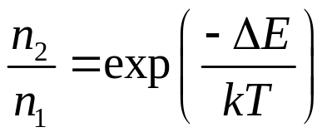
How to realize the population inversion?
Thermal excitation:
E₂
E₁
impossible.
The system has to be „pumped”
Optically,
electrically.

